Slide 1
Early Years Conference – Cairns
Today’s Children – Tomorrow’s Future
Provision of Quality Preschool Education
in Rural and Remote Queensland
Bob Perry

Slide 2

Quality Preschool Education in Rural and Remote Queensland
Universal access to preschool education
International comparisons of provision
Provisions in other Australian jurisdictions
Provisions in Queensland
  Kindergartens
  Long Day Care Centres with a Kindergarten Program
  eKindy
  Pre-Prep in Indigenous communities
  Remote Kindergarten Pilot
Quality preschool education

Slide 3
Universal access - Background
In 2007, the then Rudd Labor government declared that all Australian children would have access to quality preschool education in the year before they started compulsory schooling.
Such universal access aims to ensure that a quality preschool program is available for 15 hours per week or 600 hours a year. These programs need to meet National Quality Framework requirements and be delivered by a university educated early childhood teacher.

Slide 4
Universal access - Background
In the major and regional cities and even in many smaller country towns in Australia, such access can be provided through existing and developing centre-based early childhood programs, some of which have long and proud histories.

Slide 5
International comparisons of provision
Many international jurisdictions have much ‘higher’ standards for both provision of and entitlement to preschool programs than Australia. For example,
Country | Provision for 3 years-school start | Entitlement | Other
Chile |  | 22 h/week | 40 h/week (vulnerable) 55 h/week (working mother)
Italy | 40 h/week
Denmark, Estonia, Russia |  | Up to 12 h/day | (Bertram & Pascal, 2016)

Slide 6
Australian comparisons of provision
While Australian Government laws require certain levels of access, provision across States and Territories varies markedly.
Some jurisdictions provide most of their preschool education through preschools attached to schools (ACT, SA, WA, NT, TAS). Preschools attached to Government schools are basically free.
Other jurisdictions (NSW, QLD, VIC) provide most preschool education through preschool programs in LDC and community services which, for most families, are not basically free.

Slide 7
Research on universal access
Groups that were seen as being less likely to access ECE in the year before full-time school ... included:
children from remote communities;
children from socio-economically disadvantaged backgrounds;
children from Indigenous backgrounds;
children from non-English speaking backgrounds (NESB); and
children experiencing disability or having special health care needs. ...
Families in remote areas may have more difficulty in accessing a high-quality ECE service within a reasonable distance from their home. (Baxter & Hand, 2013, Section 4.2)

Slide 8
What is the challenge for Queensland?
All eligible children and families should have access to quality preschool (kindergarten) programs.
While more than 95% of Queensland children were enrolled in kindergarten in 2016, access for children in remote and very remote communities remained a challenge, with participation only 86.2% (ABS, 2016).
Notes:
As well as the much cited educational benefits for engagement with quality preschool programs, there is also a social justice argument that all children and families should have equal access to such programs.

Slide 9
What is the challenge for Queensland?
How can a child and family access a quality kindergarten program when, for example, you live 600 km from the nearest early childhood centre, perhaps 100 km from the nearest school, drought means that parents and other family members are focused on survival and you are the only 4-year old within 50 km?

Slide 10
How is the challenge being addressed
Queensland has developed a number of initiatives in order to meet its National Partnership obligations including the provision of universal access to quality kindergarten programs. These include:
  Centre-based kindergartens;
  Long day care centres with a kindergarten program;
  eKindy;
  eKindy ‘pods’;
  Pre-prep (Kindergarten) in Indigenous communities; and
  Remote Kindergarten Pilot

Slide 11
eKindy
“The eKindy program is a comprehensive ‘at home’ kindergarten program for children in the year before Prep. The program is supported by a qualified early childhood teacher and covers 15 hours of Kindergarten for 40 weeks a year (school terms only). The program aligns with the early years learning framework and the Queensland kindergarten learning guideline”.
(Brisbane School of Distance Education, 2018)

Slide 12
eKindy
A child is eligible for eKindy if they turn 4 by June 30 in their kindy year and:
they or their parent(s) are Australian citizens or permanent residents of Australia
they fit into one of the following categories:
Distance: their residence is at least 16 km by the most direct route by road from the nearest centre-based service catering to kindergarten-aged children.
Medical: ... they are unable to attend a centre-based service for more than 10 consecutive weeks due to their health.
Travelling/Itinerant lifestyle.
(Brisbane School of Distance Education, 2018)

Slide 13
eKindy
Enrolment in eKindy in 2018 is 202.
While eKindy has proven to be a popular choice for Queensland families in rural and remote areas, it is not a solution for all based on:
time commitment and level of parental input;
access to reliable internet;
and limited opportunities for children to socialise with their peers.

Slide 14
eKindy pods
Small schools/local community groups can:
organise times for eKindy families to ‘visit’ and use school/community site ICTs and internet for web sessions;
allow families to complete some eKindy activities as a pod operating a 'playgroup' model at the school or community site (parent must stay);
arrange with eKindy Queensland Brisbane SDE to set up an eKindy pod at the school/community site with a facilitator (working with an eKindy Queensland teacher) paid by an outside body to help deliver parts of the eKindy program up to two days per week.

Slide 15
eKindy pods
The key person in an eKindy pod is the facilitator who will “facilitate and complement the delivery of the eKindy program to kindergarten-aged children in a small school/community setting, through collaboration with the eKindy Queensland teacher, small school principal, community coordinator and parents” (BSDE, 2018).

Slide 16
eKindy pods
Requirements for an eKindy pod include:
external funding for the facilitator (see below);
up to two hours each term for facilitator professional development provided by eKindy;
time each week/fortnight for facilitator to plan program and share information about children with their eKindy teacher;
no more than four children can attend at one time;
an appropriate environment is provided for the group.
(BSDE, 2018)

Slide 17
eKindy pods
There are 19 eKindy pods currently running in Queensland.
the Department of Education is providing funding of 6.5 hours (1 day) per week to pay (at least partially) for the facilitator’s wages for each pod;
this assists with the problem of communities finding funding for wages; hence, more communities are now interested;
the Third Party provider is BushKids who is the employer of the facilitators;
the children must be registered with eKindy Queensland; and
the program is designed by the eKindy Queensland teacher.

Slide 18
Pre-prep in Indigenous communities
Pre-Prep ... provides Aboriginal and Torres Strait Islander children living in discrete communities with access to a quality early learning program that meets national quality requirements, and places a specific emphasis on play-based early learning.
Pre-Prep programs were established in different settings, including licensed childcare centres, community kindergartens and state schools across identified Indigenous communities (most on state school sites).
(Department of Education, 2018)

Slide 19

Pre-prep in Indigenous communities
Pre-Prep uses Foundations for Success to support the implementation of the Early Years Learning Framework for Australia.
Foundations for Success assists educators to plan, implement and document a quality program that builds on Indigenous children's culture, language and strengths.
(Department of Education, Training and Employment, 2013)

Slide 20
The Remote Kindergarten Pilot
The Remote Kindergarten Pilot (RKP) provides a new delivery model for kindergarten in Queensland. State schools in eligible rural and remote communities are able to express interest in offering a face-to-face kindergarten program as part of a composite class delivered by their existing classroom teacher with support from an additional teacher aide.

Slide 21
Remote Kindergarten Pilot
Selection priorities
Schools in communities:
with higher than average Indigenous populations of four year olds;
lower socio-economic status; and
where access to an approved kindergarten program is not available within 50km.
2016: 11 schools, 35 children
2017, 2018: 38 schools (not all currently with kindergarten children), 108 children in 2017.

Slide 22
Resourcing for RKP in 2017
Resourcing for the Pilot provided in addition to normal state school funding arrangements
20 hours per week extra dedicated teacher aide hours per school to meet supervision requirement and support delivery of the program;
Establishment and consumables grants;
Infrastructure and facility minor works / upgrades to ensure the safety and wellbeing of children;
Access to a qualified early childhood mentor teacher from School of Distance Education and other resources and support to assist with the integration of kindergarten children in a composite class setting; and
Enhanced and targeted professional development/training.

Slide 23
Resourcing for RKP in 2018
Major changes in resourcing include moves away from support from the eKindy Queensland staff and materials towards increased regional support, including early years coaches, and greater emphasis of the central role of the QKLG in planning and implementing curriculum.

Slide 24
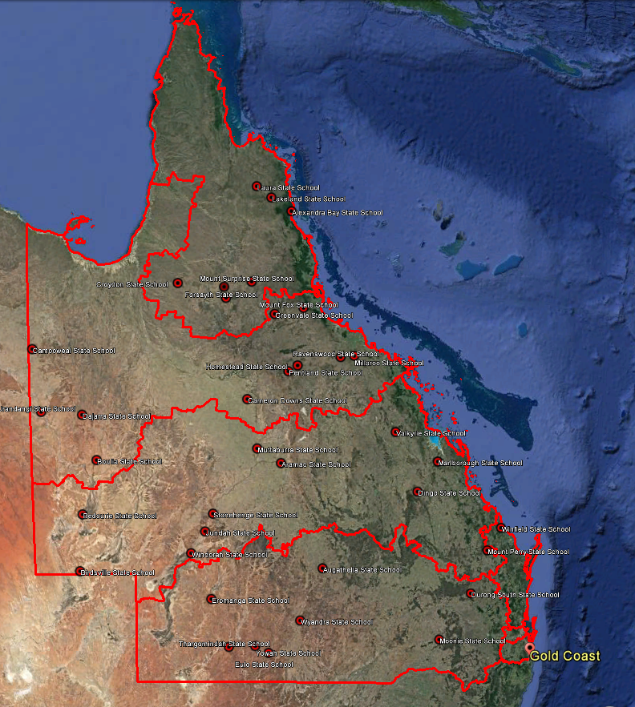
Far North Qld Region
Alexandra Bay State School
Croydon State School
Forsayth State School
Georgetown State School
Lakeland State School
Laura State School
Mount Surprise State School
North Qld Region
Boulia State School #
Cameron Downs State School
Camooweal State School
Dajarra State School
Greenvale State School #
Homestead State School
Millaroo State School
Mount Fox State School*
Pentland State School #
Ravenswood State School
Urandangi State School*
Central Qld Region
Aramac State School #
Bedourie State School* #
Birdsville State School #
Dingo State School #
Jundah State School
Marlborough State School
Mount Perry State School
Muttaburra State School #
Stonehenge State School*
Valkyrie State School #
Windorah State School
North Coast Region
Winfield State School*
Darling Downs South West Region
Augathella State School #
Durong South State School
Eromanga State School*
Eulo State School
Moonie State School
Thargomindah State School #
Wyandra State School
Yowah State School*
# 2016 schools * 2017 with no kindergarten children
Notes:
This map shows the remoteness of the 2017 pilot schools,
Laura being the most northern, more than 200 km north west of Cairns
Eulo State School is the southern, just 92km from the NSW border
Winfield, in the North Coast region is less than 6km to the coast
Camooweal State School is the most western school, just 12km from the NT border, followed by Urandangi just 35km to the NT border

Slide 25
What supports the successful implementation of RKP?
Supports identified include:
valuing of Kindergarten education;
a variety of inviting and well-equipped spaces for Kindergarten children and for integration of Kindergarten and school children;
dedicated time, competence and confidence for collaborative planning, assessment and documentation;
integrated approaches to planning, curriculum and pedagogy across Kindergarten and school children in a composite classroom;
adequate resourcing; and
professional and community support.

Slide 26
RKP - Meeting needs of children, families, educators and communities
RKP provides an opportunity for increased socialization for children and families;
RKP enhances children’s readiness for school, both socially and academically;
opportunities for a local quality Kindergarten program meet a critical need for many families;
there are health benefits from the provision of a Kindy program within remote communities, both for children and families; and
cohesion of some communities may be enhanced by the RKP provision.

Slide 27
RKP - Challenges to implementation
Recruitment and maintenance of staff;
High turnover and transience of staff and families;
The need for continuing professional learning;
Challenges in obtaining resources in a timely manner;
Coordination and consistency of advice for the RKP;
Distances travelled; and
Schoolification.
Some of these are common challenges for any educational program in remote communities while some are more specific to RKP and, more generally, the provision of quality kindergarten programs .

Slide 28
RKP - Moving towards quality preschool education
Overall, the success of RKP is reliant on building and strengthening the knowledge and skills of educators to support delivery of quality kindergarten programs (particularly in an integrated, multi-age composite model approach) in accordance with regulatory requirements.

Slide 29
RKP - Moving towards quality preschool education
While physical integration can be an important element of the composite model, planning, curriculum and pedagogical integration are required to promote quality programs. Factors that support these forms of integration are:
familiarity with both the QKLG and the Australian Curriculum and a willingness to work with different curriculum frameworks;
previous experience within a quality kindergarten program;
positive dispositions toward the implementation of a quality kindergarten program within the composite class school-based model;
sufficient confidence with the different curricula to seek potential connections; and
awareness of the National Quality Standard, particularly the elements of a quality program.

Slide 30
Moving towards quality preschool education in rural and remote Queensland
Analysis over the last 10 years of various kindergarten programs has highlighted the need for:
kindergarten programs to be regarded as much more than an extended transition to school – or school readiness – programs;
Belonging, Being and Becoming;
regular and respectful communication with the school community – particularly families – about the Kindergarten program;
kindergarten children to be regarded as competent learners, with a focus on their strengths and experiences; and
opportunities for all to reflect on practice, particularly to share effective practice and to critique existing practice.

Slide 31
Moving towards quality preschool education in rural and remote Queensland
The same analysis has shown that:
Queensland has done very well in terms of providing children and families access to kindergarten programs in rural and remote areas;
a variety of provisions exist with some choice available for families;
quality varies within and across these provisions;
it is more difficult to provide quality kindergarten programs in rural and remote areas than in metropolitan areas;
what quality looks like will vary across contexts;
there needs to be flexible application of the NQF to reflect quality in the various provisions of kindergarten in rural and remote Queensland;

Slide 32
Moving towards quality preschool education in rural and remote Queensland
‘schoolification’ impacts on quality kindergarten provision;
regional Early Childhood Coaches and Officers should help enhance the quality of kindergarten provision;
quality kindergarten provision is a social justice imperative – where your family lives should not be a determinant of the quality of your education;
access is necessary but not sufficient; and
the implementation of quality kindergarten programs takes time and requires constant, sustainable resourcing.

Slide 33
References
Australian Bureau of Statistics (ABS). (2016). Preschool education, Australia, 2016. http://www.abs.gov.au/ausstats/abs@.nsf/mf/4240.0
Baxter, J., & Hand K. (2013). Access to early childhood education in Australia (Research Report No. 24). Melbourne: Australian Institute of Family Studies. https://aifs.gov.au/publications/access-early-childhood-education-australia
Bertram T., Pascal, C. et al. (2016). Early childhood policies and systems in eight countries: Findings from IEA’s Early Childhood Education Study. Hamburg: International Association for the Evaluation of Educational Achievement. http://www.iea.nl/fileadmin/user_upload/Publications/Electronic_versions/ECES-policies_and_systems-report.pdf
Brisbane School of Distance Education (BSDE). (2018). eKindy. https://brisbanesde.eq.edu.au/Curriculum/ekindy/Pages/ekindy.aspx
Department of Education. (2018). About pre-Prep services. http://indigenous.education.qld.gov.au/pre-prep/about/Pages/default.aspx
Department of Education, Training and Employment. (2013). Foundations for success. http://www.foundationsforsuccess.qld.edu.au/sites/ffs/files/foundations-for-success.pdf

Slide 34
Contact
Bob Perry
Peridot Education Pty Ltd
peridoteducation@outlook.com

